Slide 1
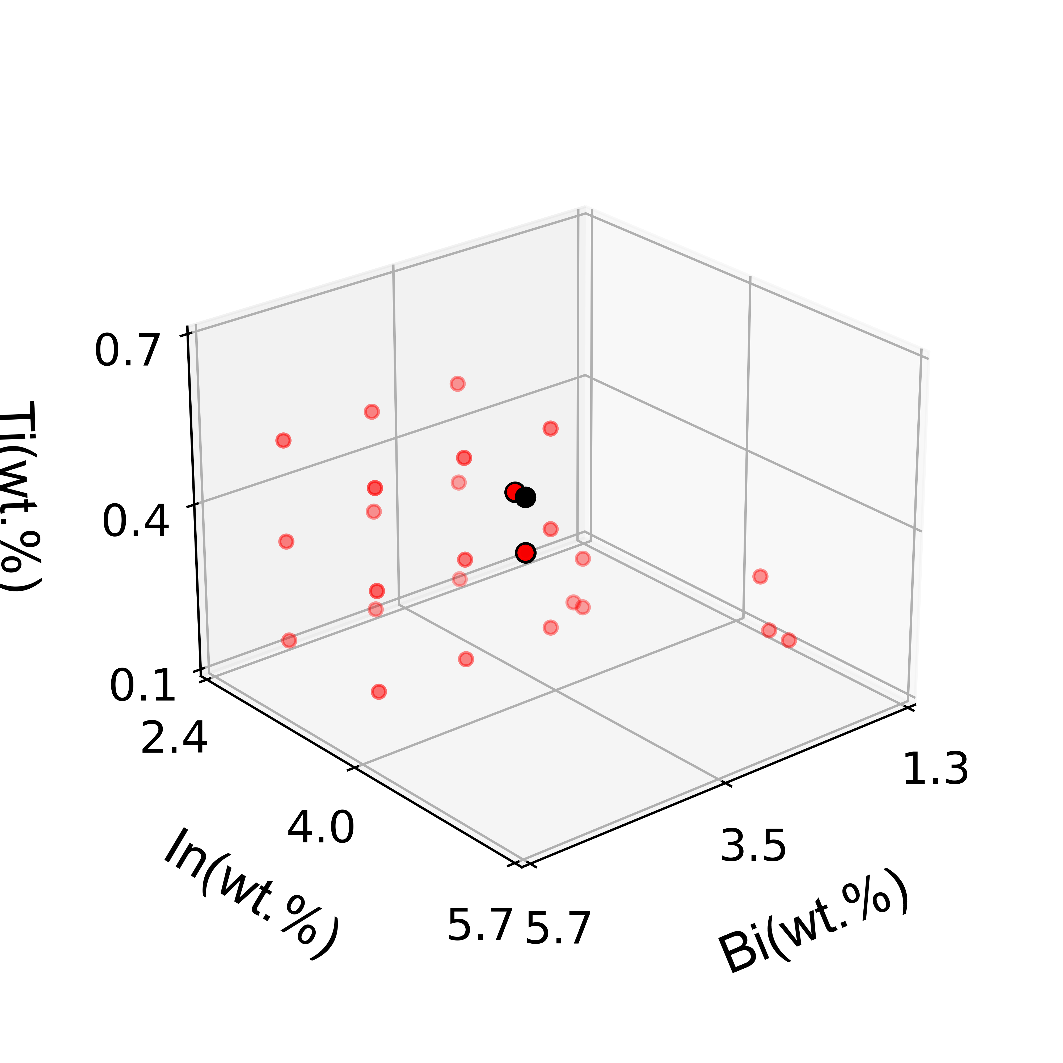

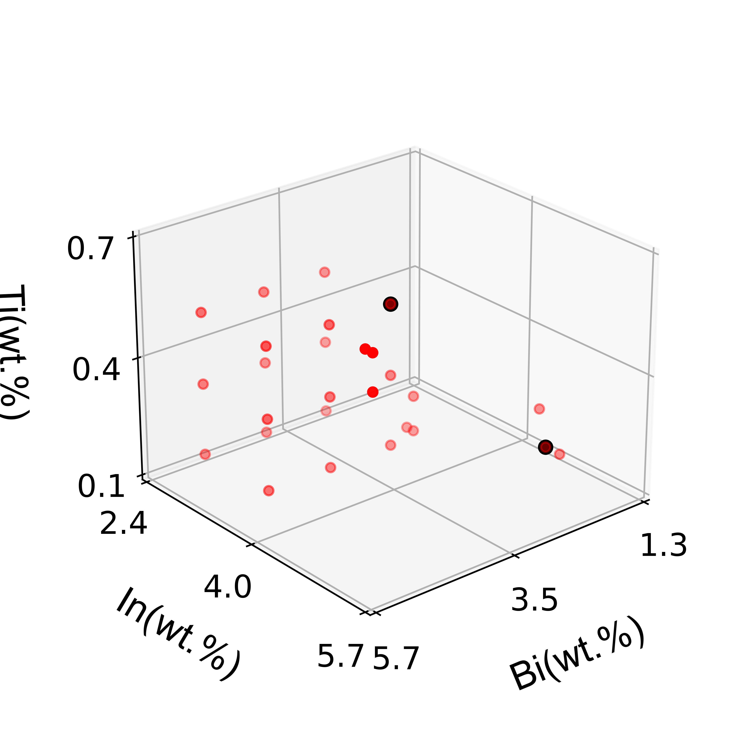
(a)
(b)
LOF
iForest
param | n_neighbors | contamination
LOF | 4 | 0.12
param | max_samples | contamination
iForest | 100 | 0.05
(c)
(d)
param | Sequence | ratio
TCGPR | ‘backaward’ | 0.03
results | LOF | iForest | TCGPR
outliers | 3 | 2 | 2
R | 0.486 | 0.501 | 0.959
TCGPR

